Slide 1
Design and Analysis of Algorithms
Text Book :
Fundamentals of Computer Algorithms, Ellis Horowitz, Satraj sahni and Rajashekaram, Galgotia publications pvt. Ltd.

Slide 2
Unit-I
Introduction:
Algorithm, Pseudo code for expressing algorithms, Performance An Algorithm, Pseudo code for expressing algorithms, Performance Analysis-Space complexity, Time complexity, Asymptotic Notation- Big oh notation, Omega notation, Theta notation and Little oh notation, Probabilistic Analysis, Connected and Bi-connected Components.

Slide 3
Algorithm
Definition
An algorithm is a set of steps used to solve a specific problem.
The word algorithm comes from the name of the person author
-Abu Jafar Mohammed Ibn Musa Al khowarizmi who wrote a text book entitled-”Algorithmi de numero indorum” Now term” Algorithmi ”in the title of the book led to the term Algorithm.

Slide 4
An algorithm is an effective method for finding out the solution for a given problem. It is a sequence of instruction
That conveys the method to address a problem
Algorithm : Step by step procedure to solve a computational problem is called Algorithm.

Slide 5
INTRODUCTION
An algorithm is a set of steps of operations to solve a problem performing calculation, data processing, and automated reasoning tasks.
An algorithm is an efficient method that can be expressed within finite amount of Time and space.
The important aspects of algorithm design include creating an efficient algorithm to solve a problem in an efficient way using minimum time and space.
To solve a problem, different approaches can be followed. Some of them can be efficient with respect to time consumption, whereas other approaches may be memory efficient.

Slide 6
PROPERTIES OF ALGORITHM
TO EVALUATE AN ALGORITHM WE HAVE TO SATISFY THE FOLLOWING CRITERIA:
INPUT: The Algorithm should be given zero or more input.
OUTPUT: At least one quantity is produced. For each input the algorithm produces a value from specific task.
3. DEFINITENESS: Each instruction is clear and unambiguous.
4. FINITENESS: If we trace out the instructions of an algorithm, then for all cases, the algorithm terminates after a finite number of steps.
5. EFFECTIVENESS: Every instruction must very basic so that it can be carried out, in principle, by a person using only pencil & paper.

Slide 7


Slide 8
Pseudo code for expressing algorithms
We present most of our algorithms using pseudo code that
looks like C and Pascal code.
  Comments begin with // and continue until end of the line.
  Blocks are indicated with matching braces: { and }.
      A compound statement.
      Body of a function.

Slide 9
  3.
    i). The data types of variables are not explicitly declared.
    ii). The types will be clear from the context.
    iii). Whether a variable is global or local to a function will also be clear from the context.

Slide 10
  4. Assignment statement
  < variable > := < expression >
  5. Boolean values are true and false.
  Logical operators are and, or and not R
  Relational operators are <, ≤, =, ≠, ≥ and >
  6. Elements of multidimensional arrays are accessed using [ and ]. For example the (i,j)th element of the array A is denoted as A[i,j].
  7. Looping statements are for, while, and repeat until.

Slide 11
The general form of a while loop:
while( condition ) do
{
statement_1;
:
statement_n;
}

Slide 12
The general form of a for loop:
for variable := value1 to value2 step step do
{
statement_1;
:
statement_n;
}
  Here value1, value2, and step are arithmetic expressions.
  The clause “step step” is optional and taken as +1 if it does not occur.
  step could be either positive or negative.
  Ex: 1: for i:= 1 to 10 step 2 do // increment by 2, 5 iterations
  2: for i:= 1 to 10 do // increment by 1, 10 iterations

Slide 13
The general form of a repeat-until loop:
  repeat
  <statement 1>
  :
  <statement n>
  until ( condition )
The statements are executed as long as condition is false.
Ex: sum:=0, number:=10;
repeat
sum := sum + number;
number := number - 1;
until number = 0;

Slide 14
  8. A conditional statements
  if< condition > then < statement >
  if< condition > then < statement 1> else
  < statement 2>
  9. Input and output are done using the instructions read and write.

Slide 15
10. Procedure or function starts with the word
Algorithm.
General form :
Algorithm Name( <parameter list> )
{
body
}
where Name is the name of the procedure.
  Simple variables to functions are passed by value.
  Arrays and records are passed by reference.

Slide 16
Ex:-Algorithm that finds and returns the
maximum of n given numbers.
Algorithm max(a,n)
// a is an array of size n
{
result:=a[1];
for i:=2 to n do
if ( a[i] > result ) then
result:=a[i];
return result;
}

Slide 17
Ex:-Write an algorithm to find sum of n numbers
Algorithm sum(a, n)
// a is an array of size n
{ sum:=0;
for i :=1 to n do
{
sum := sum+a[i];
}
return sum;
}

Slide 18
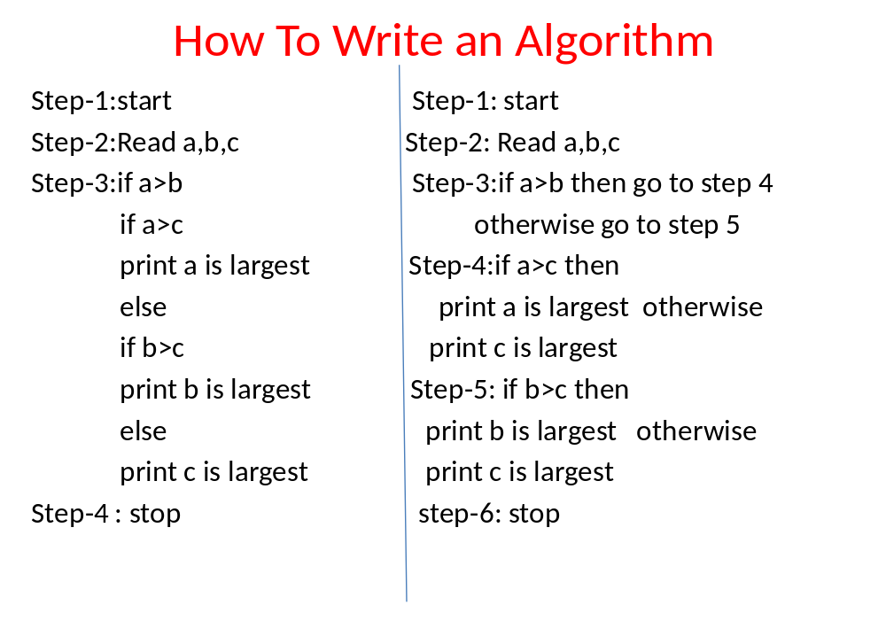

Slide 19
Differences
Algorithm Program
1.At design phase 1.At Implementation phase
2.Natural language 2.written in any programming language
3.Person should have 3.Programmer
Domain knowledge
4.Analyze 4.Testing

Slide 20
Space Complexity
The space needed by an algorithm is called a space complexity.
It has the following components.
  Instruction space / Program space
    It does not depend on the number of inputs. (Instance characteristics of a problem ).
  Data space
    Constants & simple variables – Don’t depend on the number of inputs.
    Dynamically allocated objects - Depends on the number of inputs.
    Stack space - Generally does not depend on the number of inputs unless recursive functions are in use.

Slide 21
Recursive algorithm
Algorithm rfactorial(n)
// n is an integer
{ fact=1;
if(n=1 or n=0) return fact;
else
fact=n*rfactorial(n-1);
return fact;
}
Note : Each time the recursive function is called, the current values of n, fact and the address of the next statement to return to on completion are saved on the stack.

Slide 22
Execution
n : 2
R:
n : 3
int rfactorial(n){
fact=1
if (n=0 or n=1)return fact
else
fact=n*rfactorial(n-1);
return fact;
}
void main()
{int R=rfactorial(3);
printf(R);}
int rfactorial(n){
fact=1;
if (n=0 or n=1)return fact;
else
fact=n*rfactorial(n-1);
return fact;
}
location to return
n : 1
fact
1
int rfactorial(n){
if (n=0 or n=1)
return 1;
else
fact=n*rfactorial(n-1);
return fact;
}
n
1
fact=1
4000
1
fact=2*
fact
2
n
3000
1
fact
3
fact=3*
n
2000
R
Stack

Slide 23
Contd..
  Therefore, We can divide the total space required by a
  program into two parts:
i) Fixed Space Requirements (C)
Independent of the characteristics of the problem instance ( I )
    Instruction space
    Space for simple variables and constants.
  ii) Variable Space Requirements (S_{P}(I))
  depend on the characteristics of the problem instance ( I )
    Dynamically allocated objects (Number of inputs associated with I)
    Recursive stack space ( formal parameters, local variables, return address ).
  Therefore, the space requirement of any problem P can be written as
  S(p)=C +S_{p}( Instance characteristics ).

Slide 24
Note:
  We concentrate only on estimating
  S_{p} (Instance characteristics ).
  We don’t concentrate on estimating fixed part c .
  We need to identify the instance characteristics of the problem to measure S_{p}

Slide 25
Example1
Algorithm abc(a,b,c)
{
return a+b+b*c+(a+b-c)/(a+b)+4.0;
}
Problem instance characterized by the specific values of a,b,and c.
If we assume one word (4 bytes) is adequate to store the values of each a, b, and c , then the space required by a, b, c is independent of the instance characteristics.
Therefore, S_{abc}( instance characteristics)=0

Slide 26
Example2
Algorithm sum(a,n)
{
s:=0;
for i:=1 to n do
s:=s+a[i];
return s;
}
Problem instance characterized by n.
The amount of space depends on the value of n.
Therefore, S_{sum}(n) = n

Slide 27
Example3
Algorithm RSum(a,n)
{
if(n ≤ 0) then return 0;
else return RSum(a,n-1)+a[n];
}
Type | Name | Number of bytes
formal parameter: int | a | 2
formal parameter: int | n | 2
return address ( used internally) |  | 2
Total per one recursive call |  | 6
Total no.of recursive calls n, therefore S_{RSum} (n)=6n

Slide 28
Contd..
Time Complexity:
T(P)=C+T_{P}(I)
  Time Complexity, T(P) is the sum of its compile time C plus its run time, T_{P}(I).
  Compile time does not depend on the instance characteristics( Number of inputs ).
  We will concentrate on estimating run time T_{p}(I).

Slide 29
If we know the compiler used, then we can find out the
  No. of additions , subtractions, and so on.
Then we can obtain an expression for T_{p}(n) Of the form
  T_{P}(n)=c_{a}ADD(n)+c_{s}SUB(n)+c_{m}MUL(n)+c_{d}DIV(n)+……..
  where,
  c_{a}, c_{s}, c_{m}, c_{d} and so on denote the time required for an addition , subtraction and so on.
  ADD, SUB, MUL, DIV, and so denote no.of additions, subtractions, and so on.

Slide 30
Even with this formula it is not possible to calculate the exact execution time, because time required for an addition, subtraction, and so on, depends an numbers being added, subtracted, and so on.
So, the value of T_{p}(n) for any given n can be obtained only experimentally ( using stopwatch ).
Even with the experimental approach, we face difficulties.
The execution time of a program p depends on the number of other programs running on the computer at the time program p is running.

Slide 31
Contd..
As there are some problems in finding the execution time using earlier methods, we will go one step further and count only the number of program steps.
program step
program step is loosely defined as a syntactically or semantically meaningful program statement whose execution time is independent of the number of inputs.
Example :
c := a + b;
sum := sum + a[i];

Slide 32
The number of steps contributed by any program statement depends on the kind of statement.
Comments are counted as zero number of steps.
An assignment statement which does not involve any function calls to other functions counted as one step.
For loops, such as the for, while, and repeat-until, we consider the step counts only for the control part of the statement.
The control parts for for and while statements have the following forms:
  for i:= <expr1> to <expr2> do
  while ( <expr> ) do

Slide 33
Each execution of the control part of a while statement is one, unless <expr> is a function of instance characteristics.
Similarly, each execution of the control part of a for statement is one, unless <expr1> and <expr2> are functions of the instance characteristics.
Each execution of the condition of a conditional statements step count is one, unless condition is a function of instance characteristics.
If any statement ( assignment statement, control part, condition etc.) involves function calls, then the step count is equal to the number of steps assignable to the function plus one.

Slide 34
Methods to compute the step count
  1) Introduce global variable count into the program with initial value zero.
    Statements to increment count by the appropriate amount are introduced.
    The value of the count at the time program terminates is the number steps contributed by the program.
  2) Tabular method
    Determine the number of steps contributed by each statement per execution × frequency ( number of times stmt is executed ).
    Add up the contribution of all statements

Slide 35
Method-I: Introduce variable count into programs
EX:- Iterative sum of n numbers
Algorithm sum(a, n)
{
s:=0;
  count:=count+1; // for assignment statement
for i:=1 to n do
{ count:=count+1; // For for
s:=s+a[i];
count:=count+1; // for assignment statement
}
count:=count+1; // for last time of for
return s;
count:=count+1; // for return
}
2n + 3 steps
Note : Step count tells us how the run time for a program changes with
changes in the instance characteristics.

Slide 36
Ex:- Addition of two m×n matrices
Algorithm Add(a,b,c,,m,n)
{
  for i:=1 to m do
  {
  for j:=1 to n do
  {
  c[i,j]:=a[i,j]+b[i,j];
  }
  }
  }
2mn + 2m+1 steps

Slide 37
EX:- Recursive sum of n numbers
Algorithm RSum(a,n)
{
count:=count+1; // for the if conditional
if(n ≤ 0) then
{
return 0;
count:=count+1; // for the return
}
else
{
return RSum(a,n-1)+a[n];
count:=count+1+x; // For the addition, function invocation and return
} // x = t_{RSum}(n-1)
}

Slide 38
When analyzing a recursive program for its step count, we generally obtain a recursive formula for the step count.
We obtain the following recursive formula for above (RSum) algorithm.
t_{RSum} (n)=
2
If n=0
2+ t_{RSum}(n-1)
If n>0

Slide 39
One of the ways of solving such recursive formula is by repeated substitutions for each occurrence of the function t_{RSum} on the right side until all such occurrences disappear:
t_{RSum} (n) = 2+t_{RSum}(n-1)
= 2+2+t_{RSum}(n-2)
= 2(2)+t_{RSum}(n-2)
:
:
= n(2) +t_{RSum}(n-n)
=2n+t_{RSum}(0)
= 2n+2
The step count for Rsum is 2n+2

Slide 40
Ex : Find out total step count of the following algorithm using method 1
Algorithm display( )
{
  for i := 1 to n do
  {
  for j := 1 to n do
  {
  write ( i, j );
  }
  }
  }
2n² + 2n+1 steps

Slide 41
Method-II: Tabular method
Ex:- Iterative sum of n numbers
Statement | s/e | frequency | Total steps
Algorithm sum(a, n) { s:=0 ; for i:=1 to n do s:=s+a[i]; return s; } | 0 0 1 1 1 1 0 | -- -- 1 n+1 n 1 -- | 0 0 1 n+1 n 1 0
Total |  |  | 2n+3

Slide 42
EX:- Addition of two m×n matrices
Statement | s/e | frequency | Total steps
Algorithm Add(a,b,c,m, n) { for i:=1 to m do for j:=1 to n do c[i,j]:=a[i,j]+b[i,j] ; } | 0 0 1 1 1 0 | -- -- m+1 m(n+1) mn -- | 0 0 m+1 mn+m mn 0
Total |  |  | 2mn+2m+1

Slide 43
Ex:- Recursive sum of n numbers
Statement | s/e | Frequency n=0 n>0 | Total steps n=0 n>0
Algorithm RSum(a,n) { if( n ≤ 0 ) then return 0; else return Rsum(a,n-1)+a[n] ; } | 0 0 1 1 1+x 0 | -- -- -- -- 1 1 1 0 0 1 -- -- | 0 0 0 0 1 1 1 0 0 1+x 0 0
Total |  |  | 2 2+x
x=t_{RSum}(n-1)
Note : See slide 36 for solving this recursive formula.

Slide 44
Summary of Time Complexity
The time complexity of an algorithm is given by the number of program steps taken by the algorithm.
The number of steps is a function of the instance characteristics ( number of inputs ).
Step count tells us how the run time of a program changes with changes in the number of inputs.

Slide 45
Best, Worst, Average Cases
All the inputs of a given size for a given problem, don’t take the same number of program steps.
Sequential search for Key in an array of n integers:
  Begins at the first element in array and look at each element in turn until K is found.
  Algorithm sequentialSrch( a, n, key )
  {
  for i := 1 to n do
  {
  if ( a[ i ] = key )
  { return i; }
  }
  }
Ex : Let us take , a [ ] := { 2, 5, 7, 8, 9 }
Best case, key := 2
Worst case key := 9
Avg Case , if key := 2 , total no.of steps +
if key := 5 , total no.of steps +
if key :=7, total no.of steps +
and so on by total no.of elements ( n) .
Notes:
Best: Find at first position. Cost is 1 compare.
Worst: Find at last position. Cost is n compares.
Average: (n+1)/2 compares IF we assume the element with value K is equally likely to be in any position in the array.

Slide 46
Best-Case Step count:-
Minimum number of steps taken by the algorithm for the given inputs.
2. Worst-Case Step count:-
Maximum number of steps taken by the algorithm for the given inputs.
3.Average-Case Step count:-
Average number of steps taken by an algorithm.

Slide 47
5 ms
Worst -case time
Running
Time
4 ms
3 ms
Best-case time
2 ms
1 ms
A
B
C
D
E
F
G
Input
Average-case time =
A time + B time+ ………..+G time
----------------------------------------------------
7 ( total number of elements)

Slide 48
Inexactness of step count.
  Both the instructions x=y; and x=y+z+(x/y) count as one step.
  Therefore, two analysts may arrive at 4n²+3n+2 and 7n²+6n+4 as the step count for the same program.
  Because of the inexactness of a step count , the exact step count is not very useful for comparison of algorithms.

Slide 49
Asymptotic efficiency
Asymptotic efficiency means study of algorithms efficiency / time complex for large inputs.
To compare two algorithms with running times f(n) and g(n), we need a rough measure that characterizes how fast each function grows as n grows.
Hint: use rate of growth
Compare functions asymptotically!
  (i.e., for large values of n)

Slide 50
Rate of Growth
Ex:- F(n)=n²+100n+log₁₀n+1000
n | f(n) | n² |  | 100n |  | log₁₀n |  | 1000
 | value | Value | % | value | % | value | % | value | %
1 | 1,101 | 1 | 0.1 | 100 | 9.1 | 0 | 0.0 | 1,000 | 90.83
10 | 2,101 | 100 | 4.76 | 1,000 | 47.6 | 1 | 0.05 | 1,000 | 47.60
100 | 21,002 | 10,000 | 47.6 | 10,000 | 47.6 | 2 | 0.001 | 1,000 | 4.76
1,000 | 1,101,003 | 1,000,000 | 90.8 | 100,000 | 9.1 | 3 | 0.0003 | 1,000 | 0.09
10,000 | 101,001,004 | 100,000,000 | 99.0 | 1,000,000 | 0.99 | 4 | 0.0 | 1,000 | 0.001

Slide 51
The low order terms and constants in a function are relatively insignificant for large n
n² + 100n + log₁₀n + 1000 ~ n²
i.e., we say that n² + 100n + log₁₀n + 1000 and n² have the same rate of growth
Some more examples
n⁴ + 100n² + 10n + 50 is ~n⁴
10n³ + 2n² is ~n³
n³ - n² is ~n³
constants
  10 is ~1
  1273 is ~1

Slide 52

Asymptotic Notations
Asymptotic notation describes the behavior of functions for the large inputs.
Big Oh(O) notation:
  The big oh notation specifies an upper bound for the growth rate of the function f.
Definition: [Big “oh’’]
  f(n) = O(g(n)) (read as “f of n is big oh of g of n”) iff there exist positive constants c and n₀ such that
  f(n) ≤ cg(n) for all n, n ≥ n₀.

Slide 53
The definition states that the function f(n) is at most c times the function g(n) except when n is smaller than n₀.
In other words, f(n) grows slower than or same rate as” g(n).
When providing an upper –bound function g for f, we normally use a single term in n.
Examples
  f(n) = 3n+2
    3n + 2 <= 4n, for all n >= 2, ∴ 3n + 2 = Ο (n)
  f(n) = 10n²+4n+2
    10n²+4n+2 <= 11n², for all n >= 5, ∴ 10n²+4n+2 = Ο (n²)
  f(n)=6*2^{n}+n²=O(2^{n}) /* 6*2^{n}+n² ≤ 7*2^{n} for n≥4 */

Slide 54
It also possible to write 10n²+4n+2 = O(n³) since 10n²+4n+2 <= 7n³ for n>=2
Although n³ is an upper bound for 10n²+4n+2, it is not a tight upper bound; we can find a smaller function (n² ) that satisfies big oh relation.
But, we can not write 10n²+4n+2 =O(n), since it does not satisfy the big oh relation for sufficiently large input.
Note : We always consider tight upper bound.

Slide 55

Omega (Ω) notation:
  The omega notation specifies lower bound for the growth rate of the function f.
Definition: [Omega]
  f(n) = Ω(g(n)) (read as “f of n is omega of g of n”) iff there exist positive constants c and n₀ such that f(n) ≥ cg(n) for all n,
  n ≥ n₀.

Slide 56
The definition states that the function f(n) is at least c times the function g(n) except when n is smaller than n₀.
In other words,f(n) grows faster than or same rate as” g(n).
Examples
  f(n) = 3n+2
    3n + 2 >= 3n, for all n >= 1, ∴3n + 2 = Ω (n)
  f(n) = 10n²+4n+2
    10n²+4n+2 >= n², for all n >= 1, ∴ 10n²+4n+2 = Ω (n²)
It also possible to write 10n²+4n+2 = Ω(n) since 10n²+4n+2 >=n for n>=0

Slide 57
Although n is a lower bound for 10n²+4n+2, it is not a tight lower bound; we can find a larger function (n² )that satisfies omega relation.
But, we can not write 10n²+4n+2 = Ω(n³), since it does not satisfy the omega relation for sufficiently large input.
Note : We always consider tight lower bound.

Slide 58

Theta (Θ) notation:
  The Theta notation specifies the tight upper and lower bounds for the growth rate of the function f.
Definition: [Theta]
  f(n) = Θ(g(n)) (read as “f of n is theta of g of n”) iff there exist positive constants c₁, c₂, and n₀ such that c₁g(n) ≤ f(n) ≤ c₂g(n) for all n, n ≥ n₀.

Slide 59
The definition states that the function f(n) lies between c1 times the function g(n) and c2 times the function g(n) except when n is smaller than n₀.
In other words, f(n) grows same rate as” g(n).
Examples:-
  f(n) = 3n+2
    3n <= 3n + 2 <= 4n, for all n >= 2, ∴ 3n + 2 = Θ (n)
  f(n) = 10n²+4n+2
    n²<= 10n²+4n+2 <= 11n², for all n >= 5, ∴ 10n²+4n+2 = Θ (n²)
But, we can not write either 10n²+4n+2= Θ(n) or 10n²+4n+2= Θ(n³), since neither of these will satisfy the theta relation.

Slide 60
Little Oh(O) notation:
  The little oh notation specifies a strict upper bound for the growth rate of the function f.
Definition: [Little “oh’’]
  f(n) = o(g(n)) (read as “f of n is little oh of g of n”) iff
Lim
n->∞
f(n)
= 0
g(n)

Slide 61
The definition states that the function f(n) is less than c times the function g(n) except when n is smaller than n₀.
In other words, f(n) grows slower than” g(n).
Examples
  f(n) = 3n+2=o(n²)
    since
  However, 3n+2 ≠ o(n)
Lim
n->∞
3n+2
= 0
n²

Slide 62
Big-Oh, Theta, Omega and Little-oh
Tips :
Think of O(g(n)) as “less than or equal to” g(n)
  Upper bound: “grows slower than or same rate as” g(n)
Think of Ω(g(n)) as “greater than or equal to” g(n)
  Lower bound: “grows faster than or same rate as” g(n)
Think of Θ(g(n)) as “equal to” g(n)
  “Tight” bound: same growth rate
Think of o(g(n)) as “less than to” g(n)
  Strict Upper bound: “grows slower than ” g(n)
(True for large N)

Slide 63
Functions ordered by growth rate
Function | Name
1 | Growth is constant
logn | Growth is logarithmic
n | Growth is linear
nlogn | Growth is n-log-n
n² | Growth is quadratic
n³ | Growth is cubic
2^{n} | Growth is exponential
n! | Growth is factorial
1 < logn < n < nlogn < n² < n³ < 2^{n} < n!

Slide 64
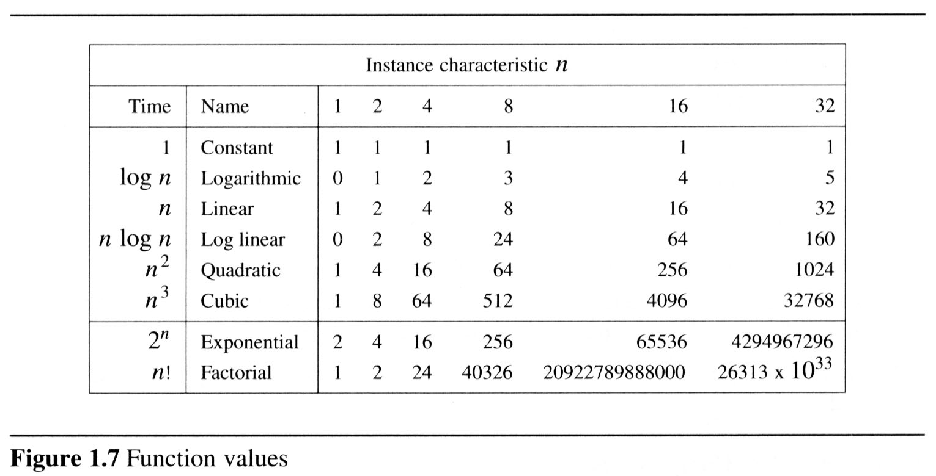
  To get a feel for how the various functions grow with n, you are advised to study the following figs:

Slide 65
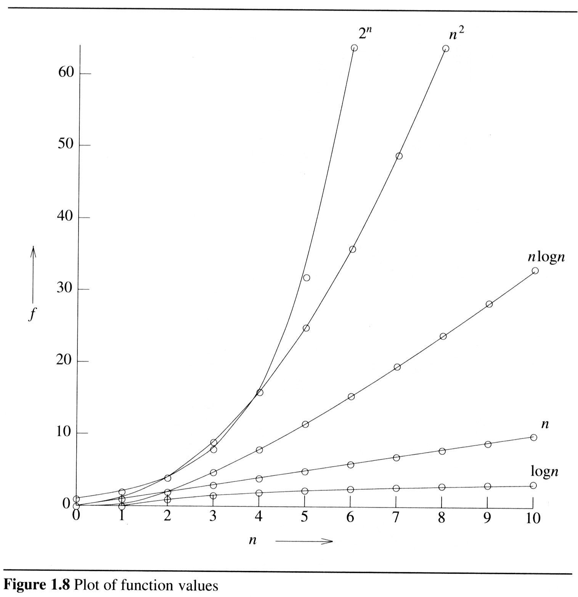
2

Slide 66
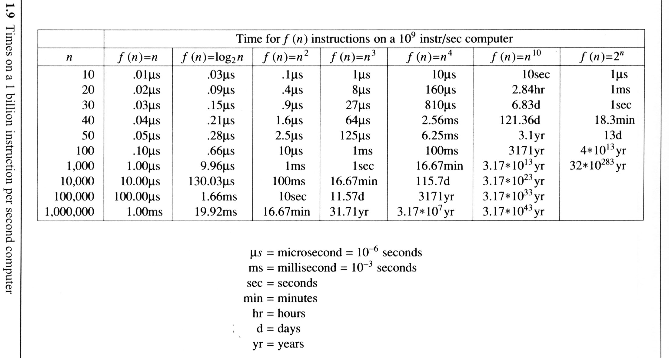
The following fig gives the time needed by a 1 billion instructions per second computer to execute a program of complexity f(n) instructions.

Slide 67
Probabilistic analysis

Slide 68
The Hiring Problem
You are using an employment agency to hire a new office assistant.
The agency sends you one candidate each day.
You interview the candidate and must immediately decide whether or not to hire that person. But if you hire, you must also fire your current office assistant—even if it’s someone you have recently hired.
Cost to interview is c_{i} per candidate.
Cost to hire is c_{h} per candidate.
You want to have, at all times, the best candidate seen so far.
When you interview a candidate who is better than your current office assistant, you fire the current assistant and hire the candidate.
You will always hire the first candidate that you interview.
Problem: What is the cost of this strategy?

Slide 69
Pseudo-code to Model the Scenario
Hire-Assistant (n)
best ← 0 ;;Candidate 0 is a least qualified candidate
for i ← 1 to n
do interview candidate i
if candidate i is better than candidate best
then best ← i
hire candidate i
Cost Model:
We are not concerned with the running time of Hire-Assistant.
We want to determine the total cost of hiring the best candidate.
If n candidates interviewed and m hired, then cost is nc_{i}+mc_{h}.
Have to pay nc_{i} to interview, no matter how many we hire.
So, focus on analyzing the hiring cost mc_{h}.
m varies with order of candidates.

Slide 70
Best-Case Analysis
Best case is when the agency sends you the best applicant on the first day.
Cost is nc_{i}+c_{h}.

Slide 71
Worst-case Analysis
In the worst case, we hire all n candidates.
This happens if each candidate is better than all those who came before. Candidates come in increasing order of quality.
Cost is nc_{i}+nc_{h}.
If this happens, we fire the agency.
What should happen in the average case?

Slide 72
Probabilistic analysis
Generally, we use probabilistic analysis to analyze the running time of an algorithm.
Sometimes, we can also use it to analyze quantities such as the hiring cost in procedure Hire-Assistant.

Slide 73

Hiring problem-Average –case Analysis
An input to the hiring problem is an ordering of the n applicants, there are n! different inputs.
Average number of candidates hired is equal to
Where p(i) is the probability of i ^{th} applicant is better than the previous i -1 applicants.

Slide 74
Probability of i^{th} applicant is better than the previous i -1 applicants = 1 / i.
Suppose n = 4 and i = 3.
Ex:-Probability that 3rd applicant is better than the 2 previous ones.
1234
1243
1324
1342
1423
1432
2134
2143
2314
2341
2413
2431
3124
3142
3214
3241
3412
3421
4123
4132
4213
4231
4312
4321
8/24 = 1/3

Slide 75

Average number of candidates hired is
=
=
= ln n+ 1
Expected hiring cost = O(c_{h}ln n).

Slide 76
Amortized Analysis
Data structures are subjected to a sequence of operations rather than one operation.
In this sequence, one operation possibly performs certain modifications that have an impact on the run time of the next operation in the sequence.
One way of assessing the worst case run time of the entire sequence is to add worst case efficiencies for each operation.
This may result in an excessively large and unrealistic time complexity.

Slide 77
Amortized analysis concentrates on finding the average complexity of a worst case sequence of operations.
Amortized analysis considers interdependence between operations.
  For example, if an array is sorted and only a very few new elements are added, then re-sorting this array will be must faster than sorting it for the first time.
You try to estimate an upper bound of the total
work T(n) required for a sequence of n operations…
Some operations may be cheap some may be expensive.
Overall, your algorithm does T(n) of work for n operations …
Therefore, by simple reasoning, the amortized cost of each
operation is T(n)/n

Slide 78
Three Methods of Amortized Analysis
Aggregate analysis:
  Total cost of n operations/n,
Accounting method:
  Assign each type of operation an (different) amortized cost
  overcharge some operations,
  store the overcharge as credit on specific objects,
  then use the credit for compensation for some later operations.
Potential method:
  Same as accounting method
  But store the credit as “potential energy” and as a whole.

